Slide 1

echinopscis:
an extensible notebook for open science on specimens
Nicky Nicolson
Kew Science
#BHLDay2023
Muséum national d’Histoire naturelle (MNHN) Paris, France, 19 April 2023

Slide 2

Context: personal & institutional
Transitioned from software development into research
Open science, take-up & how we design & build for participation
How we can use software development practices in research:
Reuse
Automation
Version control
Dependency management
Continuous integration
Also processes about communication, design & inclusion
Notes:
https://unsplash.com/photos/L94dWXNKwrY

Slide 3
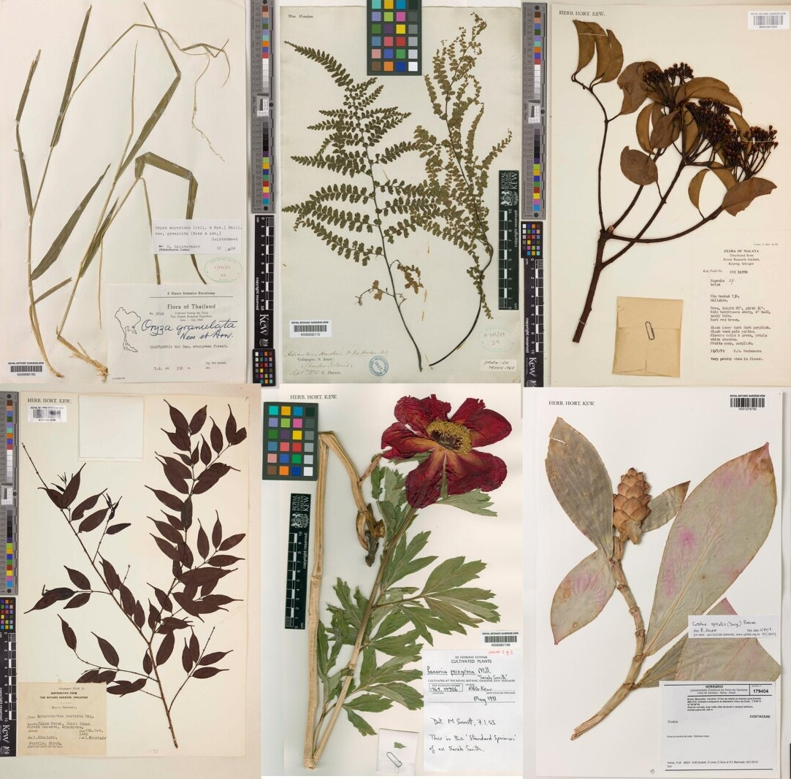
BHL launched 2006. Also: Twitter, crowd-sourcing, “e-taxonomy”
Explosion of data availability online:
Specimens online (Tracheophyta)
88 million metadata records
38 million images
Comprehensive taxonomies with distribution
Born digital and digitised literature provides context
Machine learning / AI: text / images
Recognised different roles in research
Bring your idea to the data – compute available online
Notes:
What else happened in 2006:
as a community, we were discussing “e-taxonomy”
Twitter was launched
“crowd-sourcing” was listed as one of the words of the year
We’ve done a lot but we’re still learning

Slide 4
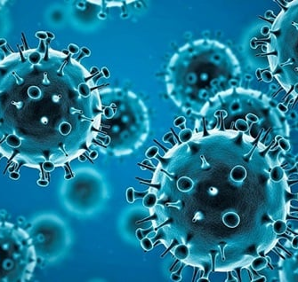
Where we work: we’re still learning how to transition online
COVID made us move everything online
When we work online, have we got a usable space, or is it “just another tab”

Slide 5
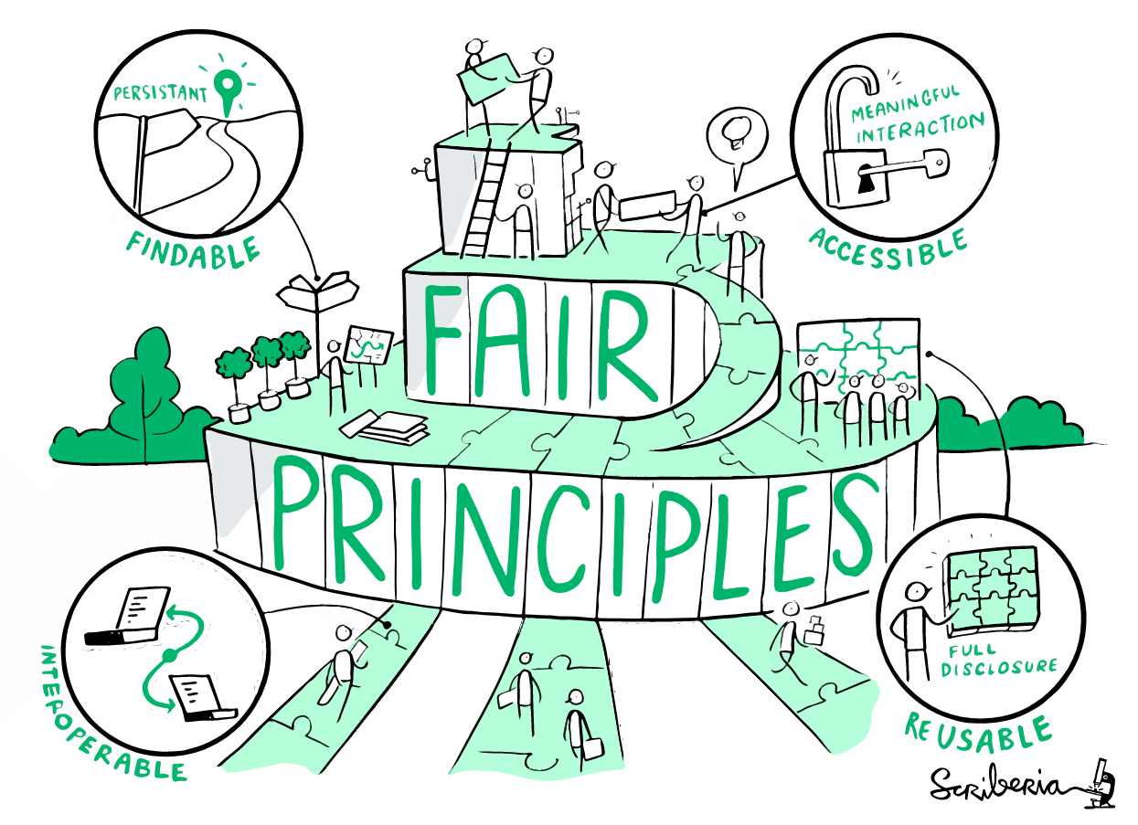
Who does the work: evolving & inclusive research culture
Skills development (Carpentries)
Awareness of different roles in research
recognition of the research software engineer role
Recognition of different activities required for successful research
Open science: open data
Online & remote collaboration

Slide 6
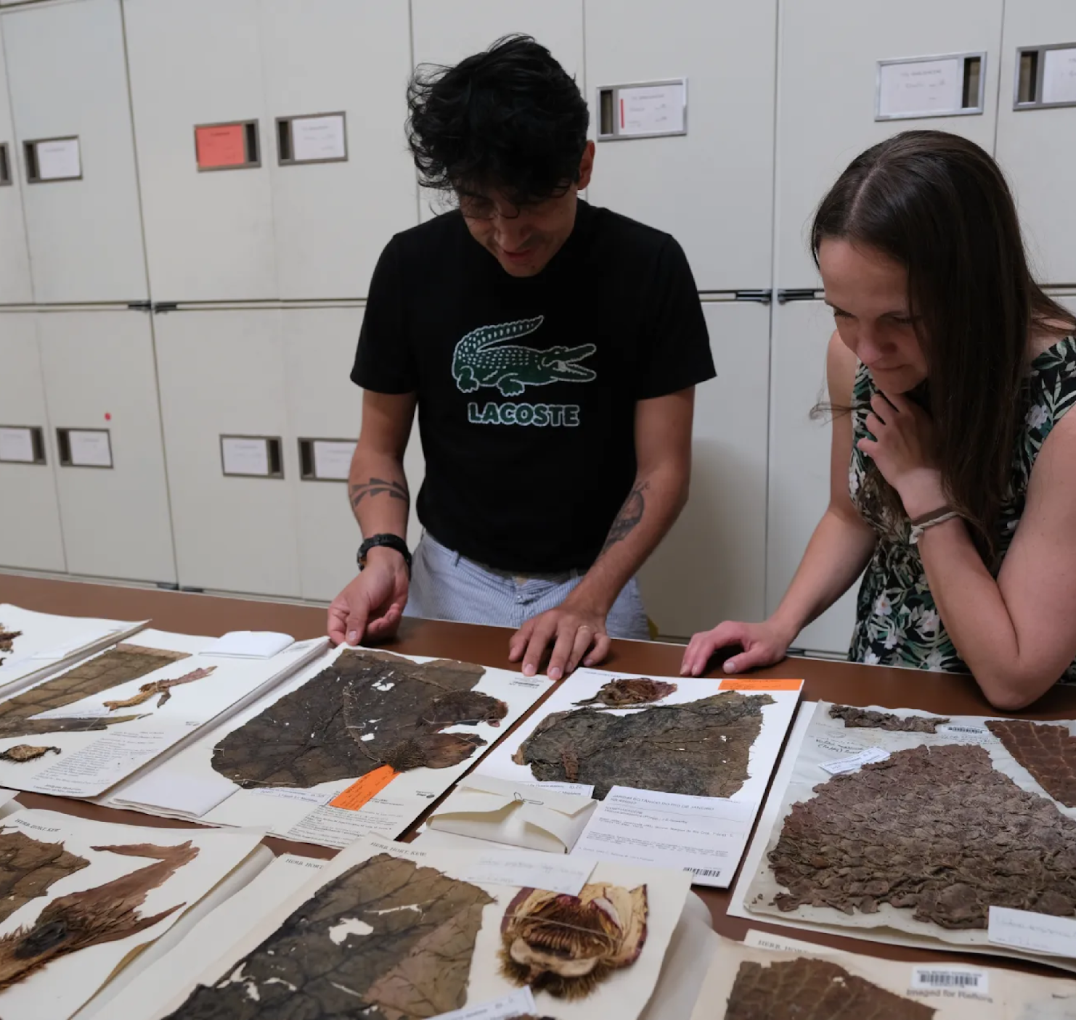
How we work: building working environments online
Inclusive design with researchers
Prototype working environment:
Streamline access
Manual processes build training data
Mobilise rich data to publications & portals
A place to plugin AI approaches as these come onstream
Notes:
https://unsplash.com/photos/L94dWXNKwrY

Slide 7

A personal knowledge manager: for creating & linking research notes
Emphasises linking
Data stored locally, using open formats
Markdown and optional structured data frontmatter
Works offline
Extensible architecture – plugins for data access and citation processing
Active user and developer community
…sounds a lot like OpenRefine, which we have adopted with some success
Could this contribute to our management of linked, semi-structured data, as Open Refine has for tabular data?
Notes:
sounds a lot like OpenRefine, which we have adopted with some success
Could this contribute to our management of linked, semi-structured data, as Open Refine has for tabular data?

Slide 8

A personal knowledge manager: for creating & linking research notes
Emphasises linking
Data stored locally, using open formats
Markdown and optional structured data frontmatter
Works offline
Extensible architecture – plugins for data access and citation processing
Active user and developer community
…sounds a lot like OpenRefine, which we have adopted with some success
Could this contribute to our management of linked, semi-structured data, as Open Refine has for tabular data?
Notes:
sounds a lot like OpenRefine, which we have adopted with some success
Could this contribute to our management of linked, semi-structured data, as Open Refine has for tabular data?

Slide 9
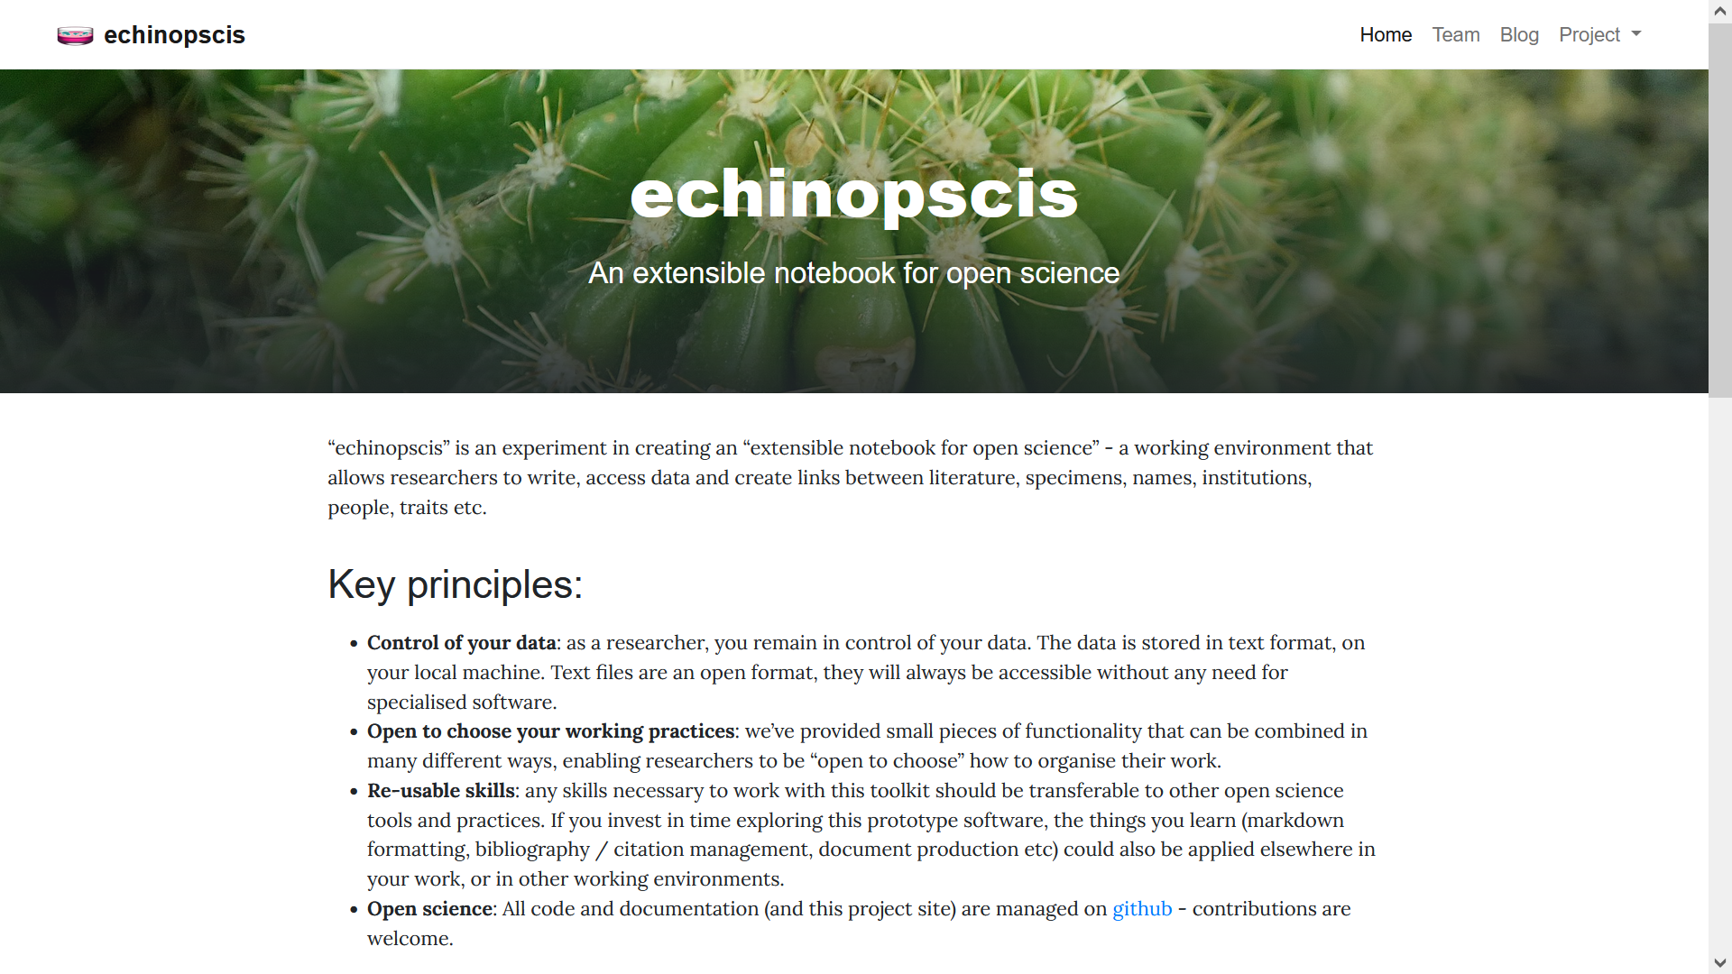
Extend Obsidian for specimen research
echinopscis.github.io
Access of relevant data
Specimens (GBIF)
Names (International Plant Names Index)
Collections (Global Registry of Scientific Collections)
People (Bionomia)
Literature (crossref)
Creation of links, spatial and network exploration
Citation in new work
Open science working practices

Slide 10
Demo: Unstructured text data to specimen links

Slide 11
Demo: “Workbench” specimen examination

Slide 12
Provisional roadmap (open to influence)
Personal research environment based on Markdown authoring and linking
Web publication using static site generators (conceptual similarities with the GBIF hosted portal work)
Document production: with structured bibliographic/specimen references
Dataset production: mobilisation of content and links into DarwinCore archives for aggregator harvesting

Slide 13


BHL relevance (1) data: integration of “meta” works like TL-2
TL-2 is entity rich:
People
Places
Institutions
Timelines
Expeditions
Bibliographic works
Eponyms
We have corrected text data in addition to BHL OCR (Smithsonian data package)
Reference resource for researchers working on Bionomia

Slide 14

BHL relevance (2) tools: provision of reference parsing APIs
echinopscis relies on “strings to things” style APIs - pass a piece of text like might be found in unstructured paragraph, get a reference to an entity back
BHL API requires atomised input
Role for BHL to provide reference parsing (whatever the approach, BHL can learn from usage traffic):
anystyle.io
ChatGPT

Slide 15


BHL relevance (3) approach: community development
Promoting use of generic tools through skills development, investing in development of research culture
Library Carpentry (short training courses)
Use of reference managers
Automated bibliographic production
Article & author identification (DOI / ORCID)
Deposition
Open Life Sciences (16 week mentoring):
Project management: “open by design”
Community building, inclusivity

Slide 16
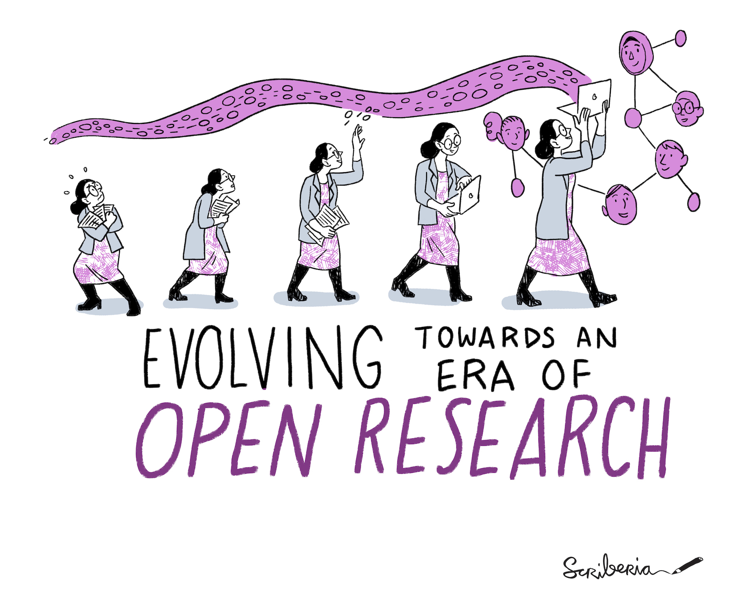
Conclusions: “e-taxonomy” lives(!) as “open science”
We’ve built an open project based on participation & reusable skills
Include people where they are now, show a relevant path to destination
Extensible with AI approaches (entity identification, clustering, summarisation, link prediction)
Usable today with generic skills - try it out: https://echinopscis.github.io
n.nicolson@kew.org / @nickynicolson / @nickynicolson@mastodon.social

Slide 17
Image credits
Slide 2: Leather toolbelt by jesse orrico (jessedo81) on Unsplash
Slides 3 & 6: RBG Kew
Slide 4: WHO
Slides 5 & 16: The Turing Way project illustration by Scriberia. Used under a CC-BY 4.0 licence. DOI: 10.5281/zenodo.3332807
Useful links
echinopscis: https://echinopscis.github.io
Obsidian: https://obsidian.md/ & Obsidian roundup (weekly newsletter): https://www.eleanorkonik.com/tag/roundup/
Open Refine: https://www.openrefine.org
Training resources:
Carpentries (including Library Carpentry): https://carpentries.org/
The Turing Way: https://the-turing-way.netlify.app/
Open Life Sciences: https://openlifesci.org/
Contact
Email: n.nicolson@kew.org
Github: @nickynicolson
Twitter: @nickynicolson
Mastodon: @nickynicolson@mastodon.social
Web: https://www.kew.org/science/our-science/people/nicky-nicolson

